Slide 1
Automated Detection of Cyberbullying Occurrences in Social Media Posts Through Text Classification Using Support Vector Machine (SVM) Algorithm
Samantha Mallari
Faith Ballesteros
Eva Samillano

Slide 2
Background of the Problem
How bullying changed over a period of time
-Its first discovery on primates
-During the era of the Homo-sapiens
-Bullying in the 21st century
Bullying-like behaviors are part of the human nature

Slide 3
Background of the Problem
Introduction to cyberbullying
Must be:
-involuntary
-harmful/offensive
-repetitive
-utilized technology as medium

Slide 4
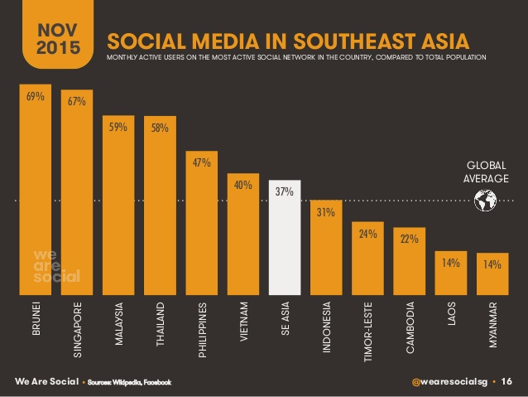
Background of the Problem
Cyberbullying in the Philippines

Slide 5
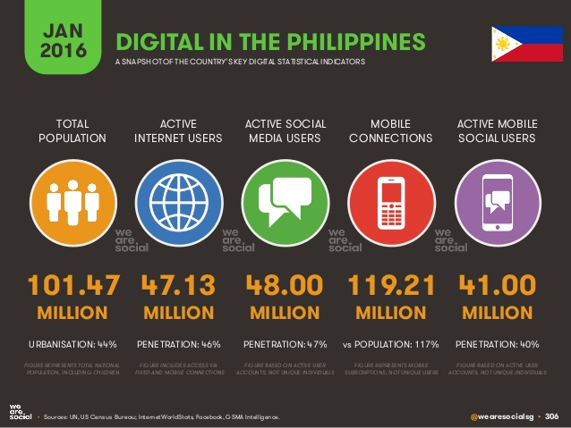
Background of the Problem
Cyberbullying in the Philippines

Slide 6
Background of the Problem
Cyberbullying in the Philippines
Countermeasures:
- R.A. 10627 – Anti-bullying Act of 2013
- House Bill 5718 – Anti-cyberbullying Act of 2015

Slide 7
Statement of the Problem
How can the automation of detecting cyberbullying occurrences in public social media posts be made possible with the aid of the concept of text classification?

Slide 8
Objective
Main Objective
This research aims to formulate a cyberbullying detection model which will yield at least 70-80% accuracy in terms of detecting cyberbullying occurrences present in public social media posts.

Slide 9
Objective
Specific Objectives
- To acquire data for the corpus
- To apply text pre-processing methods (such as annotation, cleaning of the dataset, and tokenization) to the statements included in the dataset
- To extract significant features from the corpus
- To evaluate the extracted features

Slide 10
Objective
Specific Objectives
- To classify the weighted features in their respective classes (predefined classes)
- To combine groups of classes in any way possible
- To compute for the Precision, Recall, F-measure and Kappa Statistic for each group that is being experimented on
- To verify the model’s accuracy with the help of the SVM algorithm

Slide 11
Significance
Improvement in terms of social media monitoring
The impact of the proliferation of Social Networking Sites (SNS) to cyberbullying and the countermeasures that renowned SNS had implemented against it
The benefits that the model will be able to impart on developers and researchers alike
Prevention of cyberbullying occurrences among adolescents
Give parents the ability to look into their child’s safety within the cyberspace

Slide 12
Scope and Limitations
The cyberbullying detection model will be designed to possess the ability to analyze and classify posts that were written only in Filipino, specifically as to how it is spoken in Metro Manila
The model will flag cyberbullying events revolving around issues that are highly likely to be considered “sensitive” nationwide (or by most Filipinos)
The system will only analyze posts that are available to the public
All statements (included in the corpus) were extracted from controversial posts in Twitter, Facebook, and Youtube

Slide 13
Scope and Limitations
The text pre-processing methods that will be used are the following: annotation, cleaning of the dataset, and tokenization
Classes will be formed based on the results of the interview that will be conducted on at most 20 people (of different background)
For the feature extraction, the Bag-of-Words (BoW) method will be used for all n-grams (unigram, bigram, and trigram)
The model accuracy of the model will be tested against the SVM machine learning algorithm. It must yield an accuracy rate of at least 70-80% for it to become an acceptable output

Slide 14
Review of Related Literature
Modelling the Detection of Textual Cyberbullying - 2011 (Dinakar et al.)
Improved Cyberbullying Detection using Gender Information – 2012 (Dadvar, Jong, Ordeiman, Trieschnigg)
A Framework for Cyberbullying Detection in Social Network – 2015 (Kansara, Shekokar)
Approaches for Mining YouTube Videos Metadata in Cyberbullying Detection – 2015 (Marathe, Shirsat)
Automatic Detection and Prevention of Cyberbullying – 2015 (Van Hee et al.)

Slide 15
Review of Related Literature
Automated Role Detection in Cyberbullying Incidents – 2016 (Cheng, Ng)
Automatic Monitoring and Prevention of Cyberbullying – 2016 (Sugandhi, Pande, Agrawal, Bhagat)
Cyberbullying Detection Using Sentimental Analysis on Social Media – 2016 (Sintaha et al.)

Slide 16
Theoretical Background
Ervin Goffman introduced the mechanisms of audience segregation. He describes how people play different roles in different situations. It is a mechanism wherein an individual perform roles, in order to create a favorable image of themselves and leave a good impression to others that is linked to the role they perform. The role that the individual performs is based on who their audience is.

Slide 17
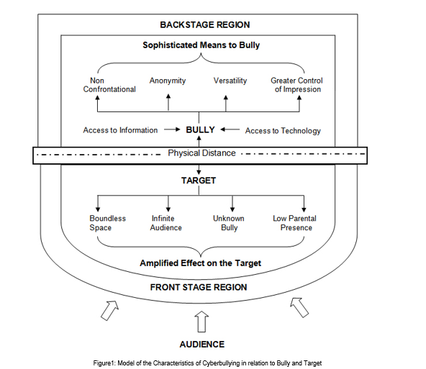

Slide 18
Design and Methodology
Corpus Update !!!
From 625 Data Last Term
2000 Data Set

Slide 19



Design and Methodology
Software Applications Used

Slide 20
Design and Methodology
Annotated Part
Now:
0=definitely not cyberbullying
1= definitely cyberbullying
2= ambiguous regarding cyberbullying
Before:
Harmness_0
Harmness_1
Harmness_2

Slide 21
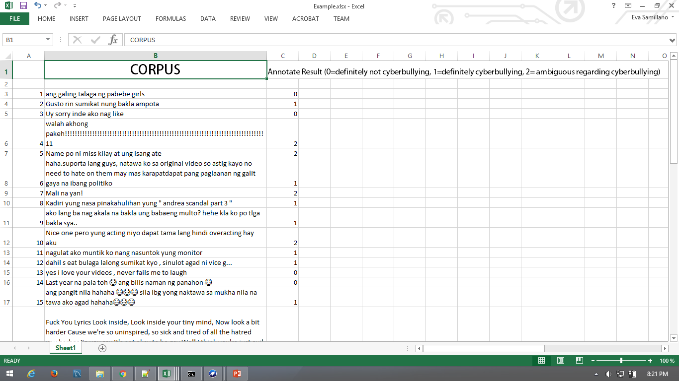
Design and Methodology
Sample for Preprocessing
Randomly from the 2k corpus, we get 50 sentences for sample

Slide 22
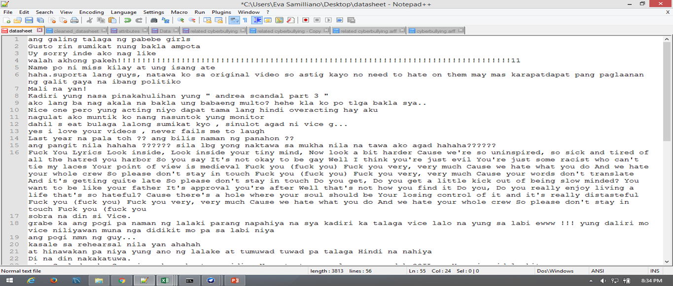
Design and Methodology
Sample for Preprocessing
Cleaning of Data using Notepad ++

Slide 23
Design and Methodology
Bag-of-words
→ a text (such as a sentence or a document) is represented as a bag (multiset) of its words
→ disregards grammar and word order but retains multiplicity
N-gram
a model that can be used to store spatial information within the text
e.g. Unigram, Bigram, Trigram, etc

Slide 24
Design and Methodology
Example:
John likes to watch movies. Mary likes movies too.
[
"John",
"likes",
"to",
"watch",
"movies",
"also",
"football",
"games",
"Mary",
"too"
]

Slide 25
Design and Methodology
Example:
John likes to watch movies. Mary likes movies too.
[
"John likes",
"likes to",
"to watch",
"watch movies",
"Mary likes",
"likes movies",
"movies too",
]

Slide 26
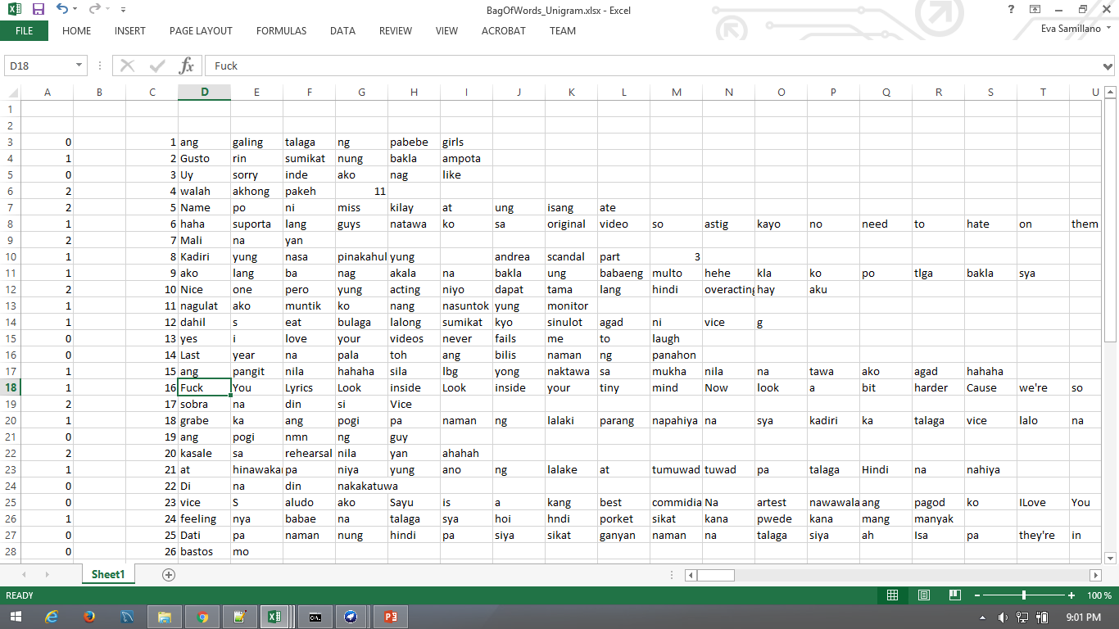
Design and Methodology
Sample of a Unigram

Slide 27
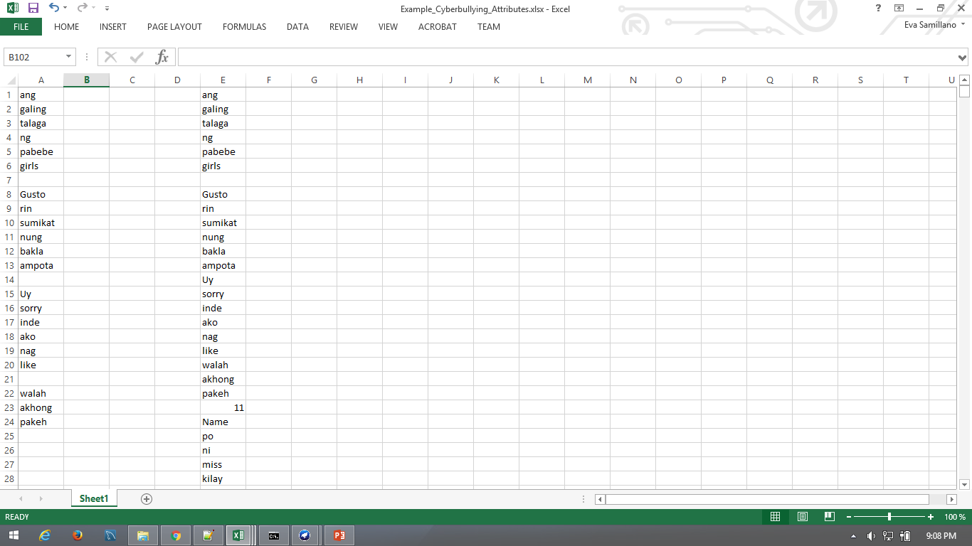
Design and Methodology
Creating the BoW for the Unigram

Slide 28
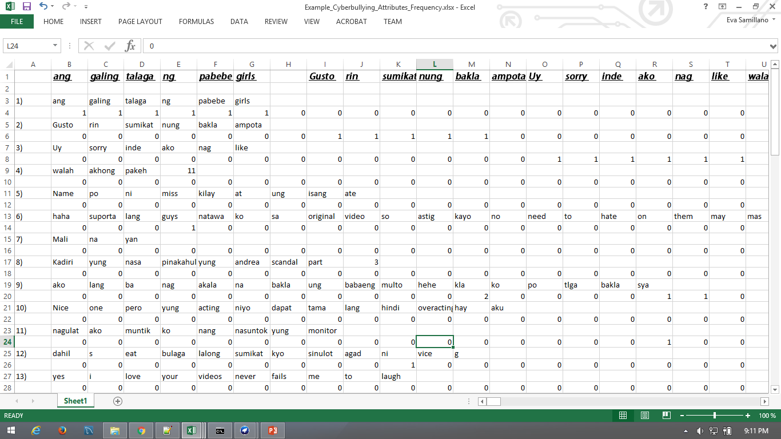
Design and Methodology
After implementing BoW, we can calculate various measures to characterize text (term frequency)

Slide 29
Design and Methodology
Reminders:
Bag-of-unigram will become ATTRIBUTE
Values or number of calculated, characterize text will become DATA
Annotated part before will become CLASS

Slide 30
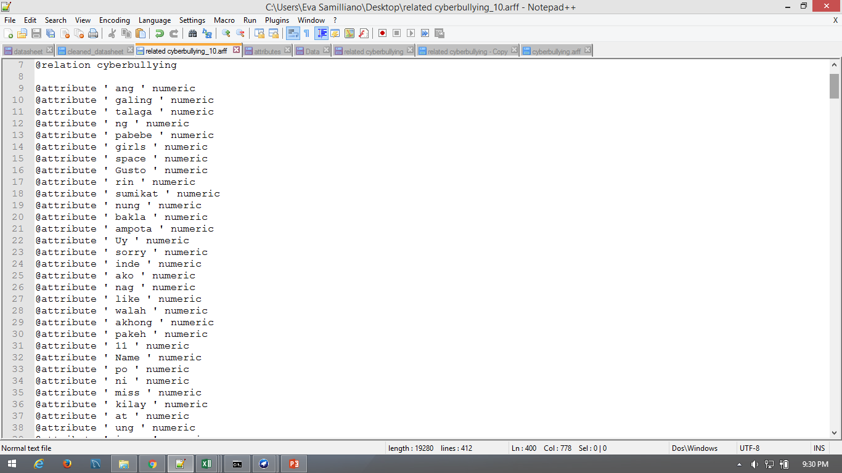
Design and Methodology
.Arff (Attribute-Relation File Format) Style

Slide 31
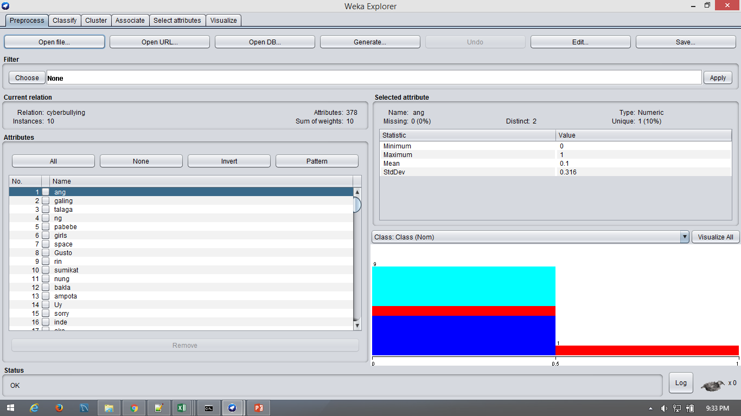
Design and Methodology
Open the file into Weka to see visualize the data

Slide 32
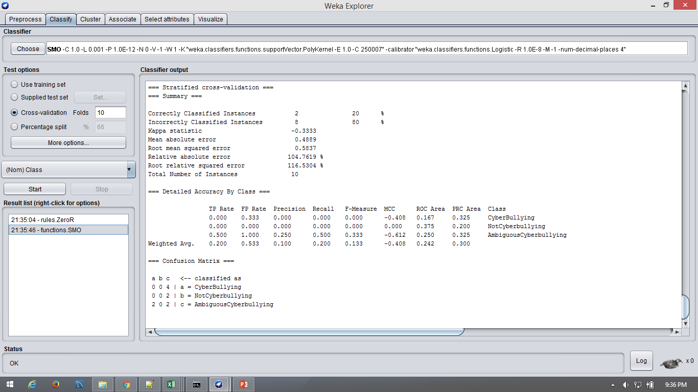
Design and Methodology
Then go to classify and choose SMO(Sequential minimal optimization) its an algorithm for solving the quadratic programming problem that arises during the training of support vector machines

Slide 33
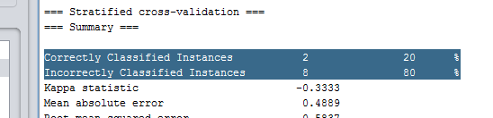
Results and Discussion
First result: 20% stand for the currently performance of the system but remember our data that we input here was only 10 were not yet done.

Slide 34
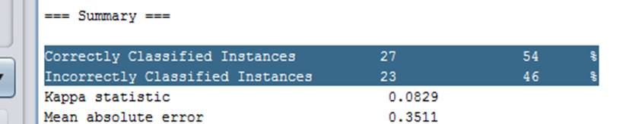
Results and Discussion

Slide 35
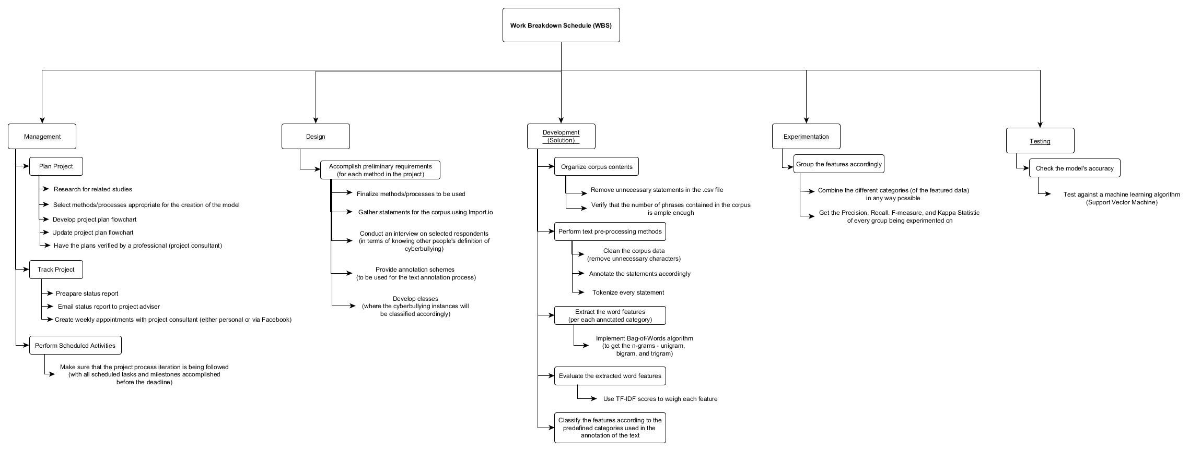
Work Breakdown Schedule (WBS)

